Slide 1

Pre-Departure Session:
Austria and Italy
- updated September 6, 2017

Slide 2
Agenda
Cross-cultural experiences
Travel preparation
Personal safety
Ryerson travelers are savvy travelers

Slide 3
Cross-Cultural Experience
What is Culture?
  “A complex whole which includes knowledge, belief, art, morals, law, custom, and other capabilities acquired by man as a member of society”. (1870s anthropologist Edward Tylor)
What we see as ‘normal’ is largely a result of the cultures we come from

Slide 4
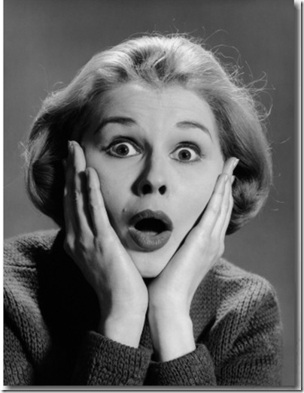
3 Stages of ‘Culture Shock’
Honeymoon
  Love it! – novelty and adventure
Culture Shock
  Loathe it! – “This is NOT the way things are meant to be!”
  ‘Cognitive dissonance’
Acceptance
  Adjust to it! – finding ways to cope

Slide 5
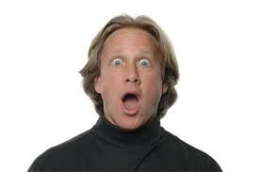
Culture Shock
Am I feeling it?
Know what to expect! Some of the symptoms of Culture Shock are:
  Feelings of withdrawal
  Feeling angry over minor inconveniences
  Sudden feeling of intense loyalty to home
  Changes in appetite or energy level
  Depression or unexplainable crying
  Exaggerated cleanliness
  …

Slide 6
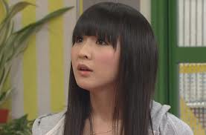
Culture Shock
Strategies for coping with life abroad:
Keep in touch with the familiar
Keep a journal
Get active, get involved
Find out more
Recognize what you’re going through
  Knowing you’re suffering from culture shock can make it easier to survive it – this too shall pass.
  In the end, a fantastic learning experience

Slide 7
Travel Preparation
Passports and Visas
Medical Matters
Insurance (Travel, Health)
Money
Home and Family Considerations
Research
Packing
Ryerson Pre-Departure Protocols

Slide 8
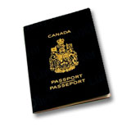
Canadian Passports
Apply for a passport as soon as possible
Ensure that the expiry date of your passport is well beyond your return date (at least 6 months).
Make photocopies of your passport’s ID page
If your passport is lost or stolen
  Report the theft to the police immediately
  Contact a Canadian mission for a replacement
Guard your passport carefully; Do not leave it unattended…ever.

Slide 9
Medical Matters
For expert medical advice, see your doctor
Some nations require proof of vaccinations for entry
See your health care provider:
  Your ‘usual’ immunizations are up to date
  Determine any specific immunizations for your destination
  Get advice regarding other health risks/issues
See www.iamat.org for comprehensive information
See www.phac-aspc.gc.ca for information from the Public Health Agency of Canada
If you feel ill after returning home, it is worth a trip to the Dr. – be sure to draw attention to your travels

Slide 10
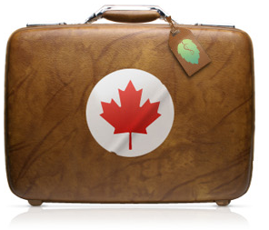
Travel Insurance
Type of insurance depends on type of travel and length of stay in the host country.
You should seriously consider trip cancellation, property and credit card insurance to cover accidents or loss.
Questions you should ask:
  What does the insurance cover or not cover?
  What is the deductible?
  Do I need a rider on my laptop? My camera?
  Is there a maximum amount I can claim?
  Should I consider personal liability insurance?

Slide 11
Health Insurance
You must arrange for health coverage for the period you are away
Specific travel health insurance strongly recommended
  You may already be covered (see RSU website)
Many companies demand that they are consulted prior to engaging services – make sure you have contact information on your person (usually a wallet card)
  “I fell down and hurt myself”
Be sure ANY plan you consider includes ‘emergency evacuation/repatriation’ coverage

Slide 12

Money Issues
CAD$1 = €0.69 €10.00 = CAD$14.57
DO NOT carry large amounts of money if possible
Keep money in a money belt
Consider keeping a separate emergency ‘stash’ on you

Slide 13
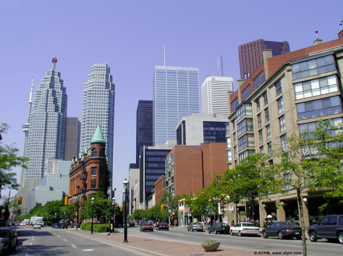
Before you go… Home and family considerations
Your family should be given a contact name and number for someone that they can rely on at your destination in the event of an emergency at either end.
Leave a copy of your itinerary, complete with contact phone numbers, with family or friends at home in case they need to contact you in an emergency.

Slide 14
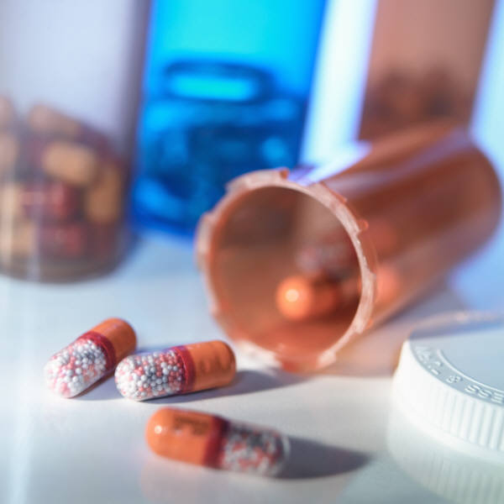
Before you go… Prescriptions
Take copies of your prescriptions for glasses and/or medication (and the generic names of the drug(s)) with you.
  Leave them in their original (marked) containers
  If a medication is unusual or contains narcotics, carry a letter from your doctor attesting to your need to take the drug.
Place your medication(s) in your carry-on luggage
  But, be aware of security regulations (liquids and gels)

Slide 15
Before you go… Medical Records
Leave a copy of your medical file with a trusted family member that can be contacted at any time day or night.
  These records could be invaluable to an attending physician should you require medical assistance
Consider bringing a summarized version of your medical records with you on your trip.
Know your blood type and any allergies (and how to explain them in the local language)!

Slide 16
Before you go… Research
Get yourself a map.
  Various Internet resources will help in this regard. For example, many hotels, city halls, tourism & information centers will have these available on their websites.
On your map, locate your hotel, place of study, police stations, hospitals, embassy, and some landmarks in between.
Through your research, if you have identified areas to stay away from, mark these on the map also.

Slide 17

Before you go… Leave it Behind
Valuable or expensive-looking jewelry, watches or electronics
Irreplaceable family objects
All unnecessary credit cards, Social Security card, library cards and similar items you may routinely carry in your wallet

Slide 18
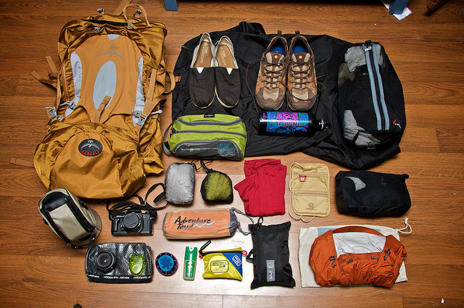
Before you go… Packing
Always try to travel light.
  You can move more quickly.
  You also will be less tired and less likely to set your luggage down, leaving it unattended
Try to stick to ONE bag if possible
Keep valuables in your carry-on bag
Use covered luggage tags and otherwise avoid ornamenting your baggage (Canadian flag patches, we mean you!)
If you can’t bear to lose it, don’t bring it!

Slide 19

Before you go…
See Global Affairs Canada (GAC) for:
  Travel Report – risks & practicalities
  Country Profile – facts & figures
  Country Insights – culture & customs
  Registry of Canadians Abroad (ROCA) service
www.travel.gc.ca

Slide 20
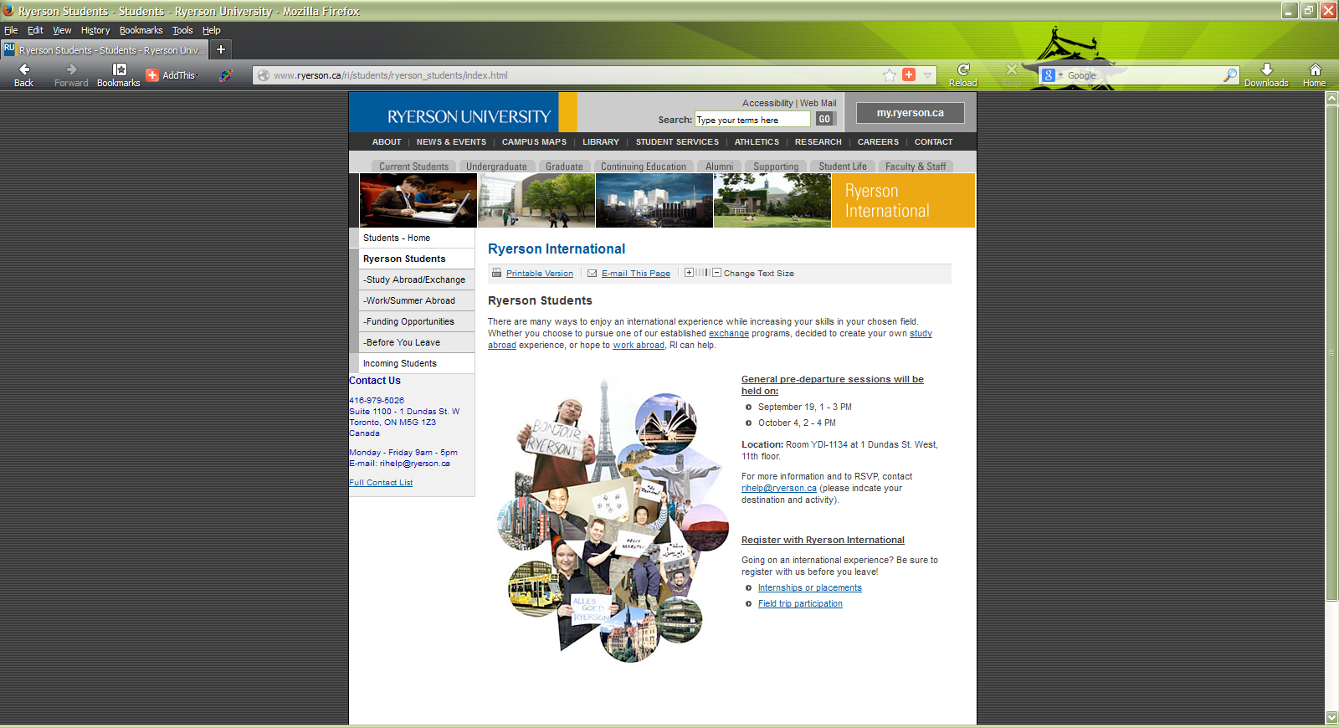

Slide 21
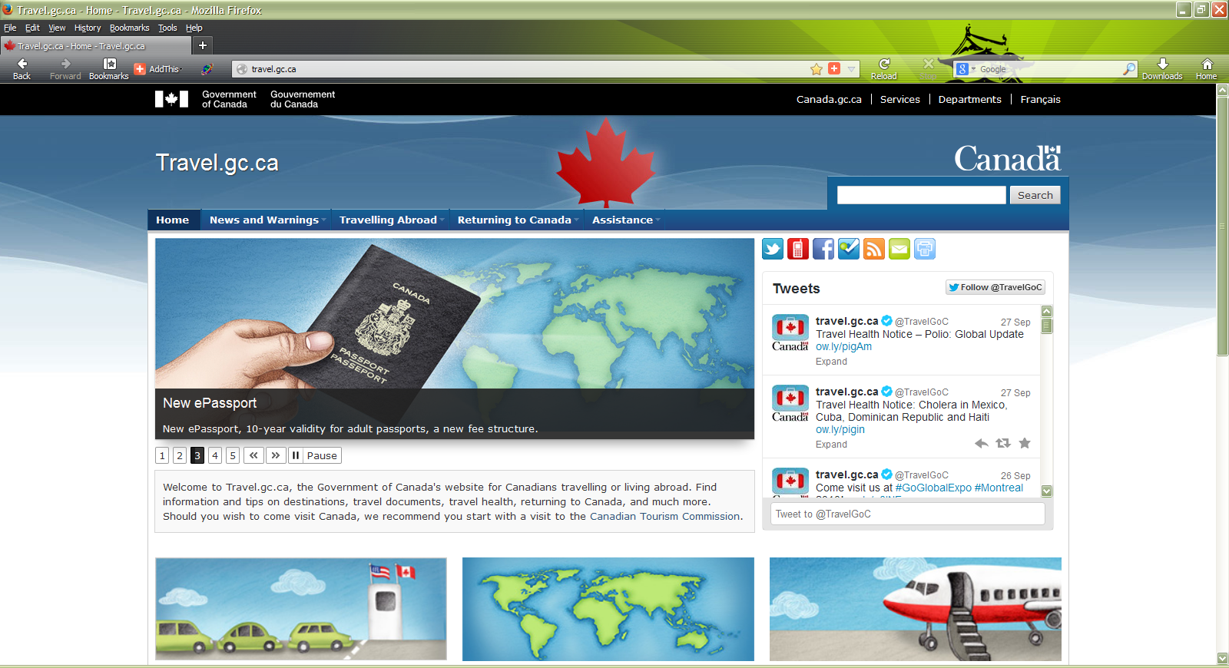

Slide 22
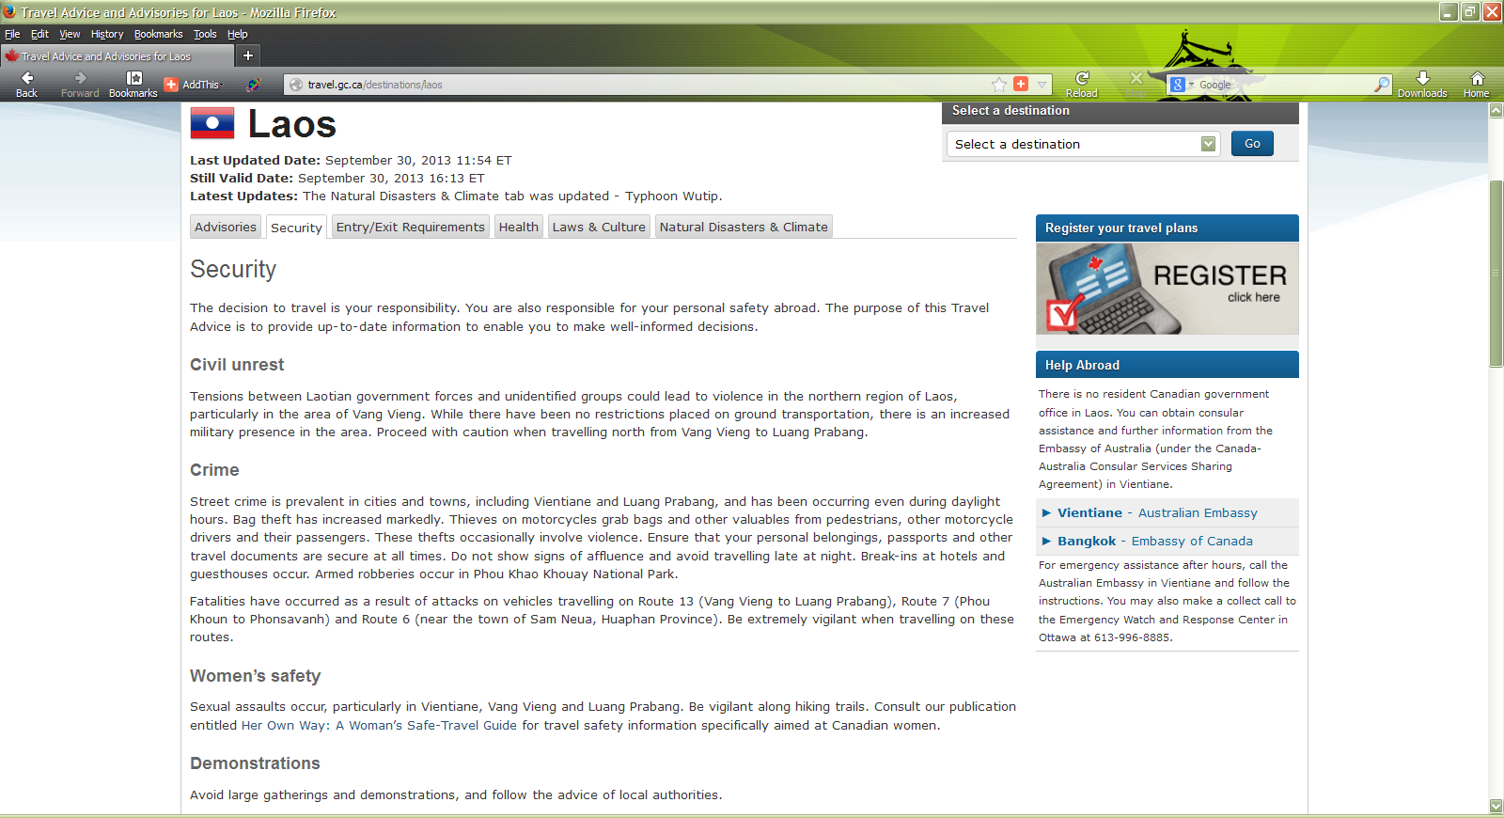

Slide 23
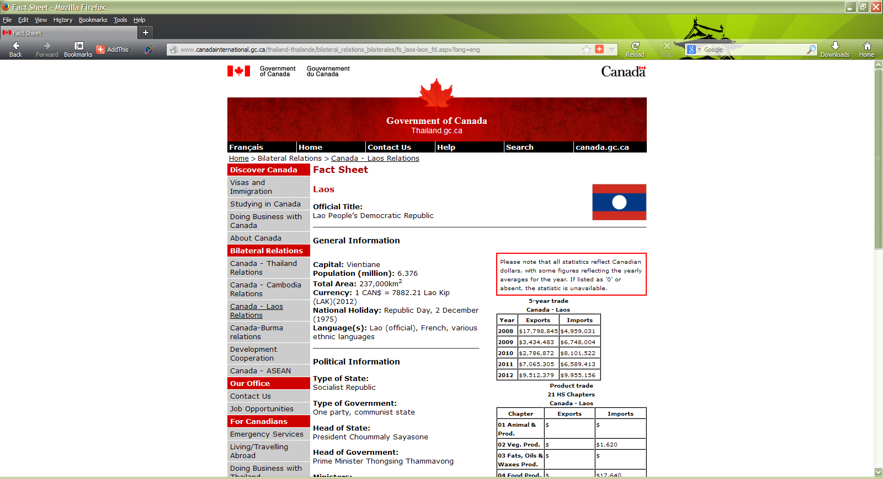

Slide 24
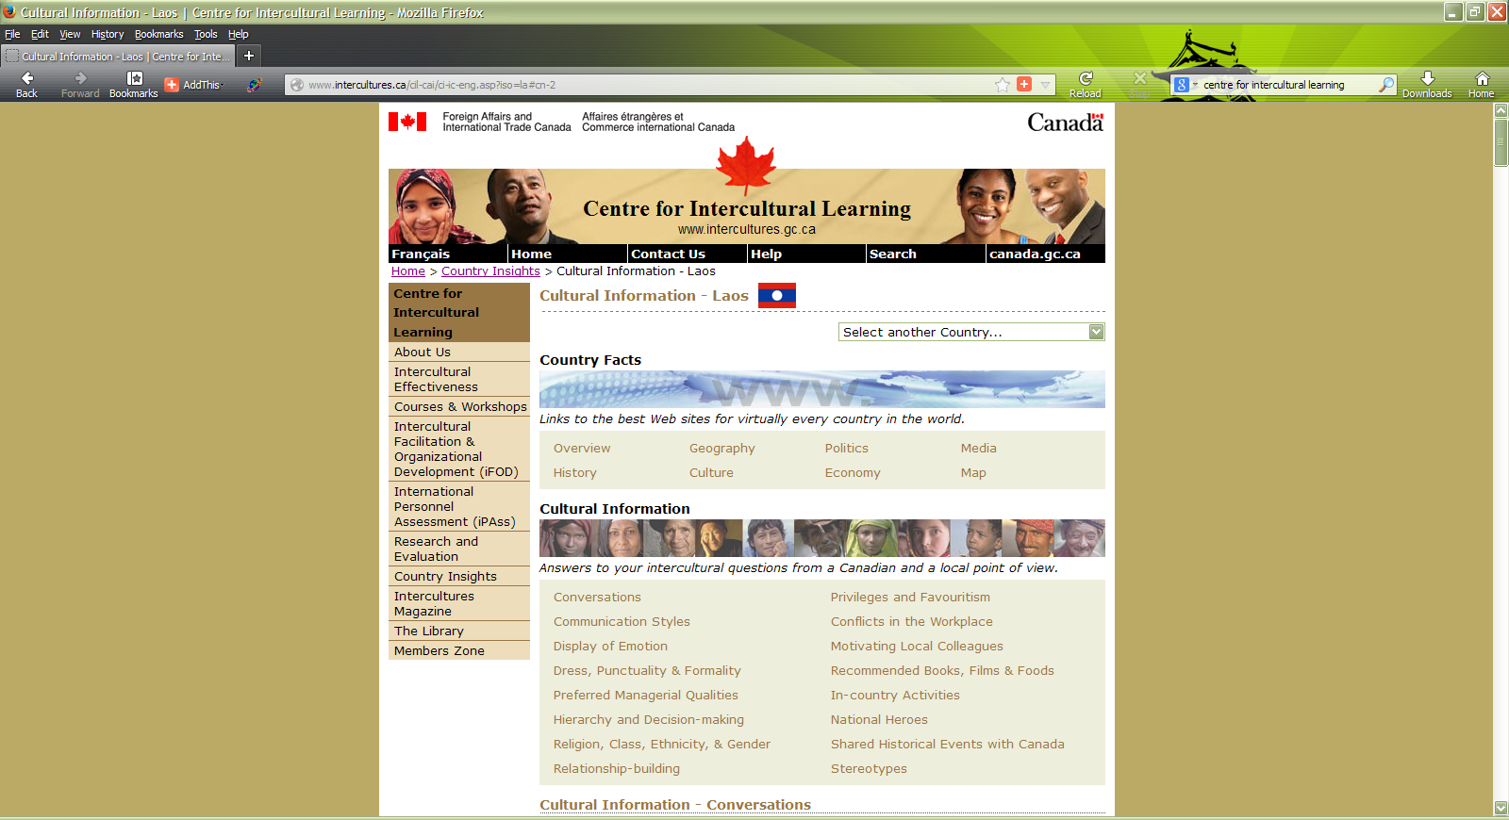

Slide 25
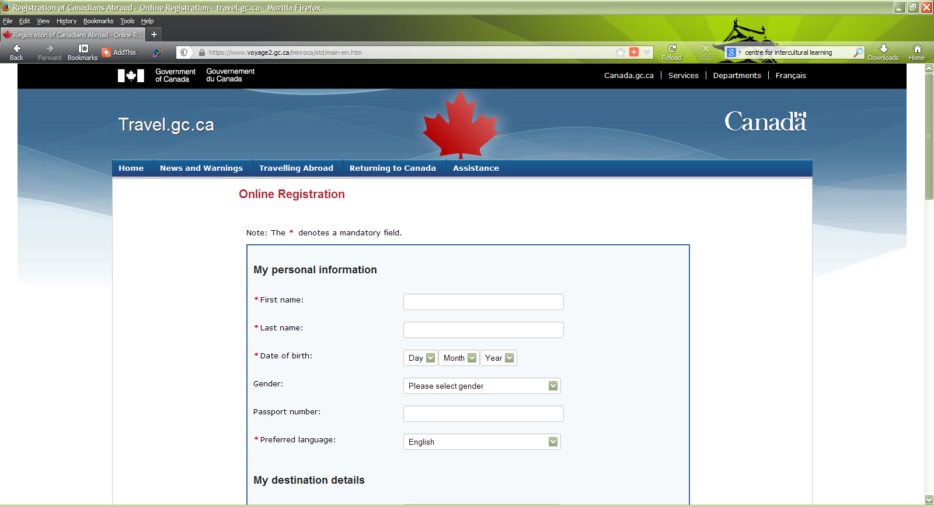

Slide 26
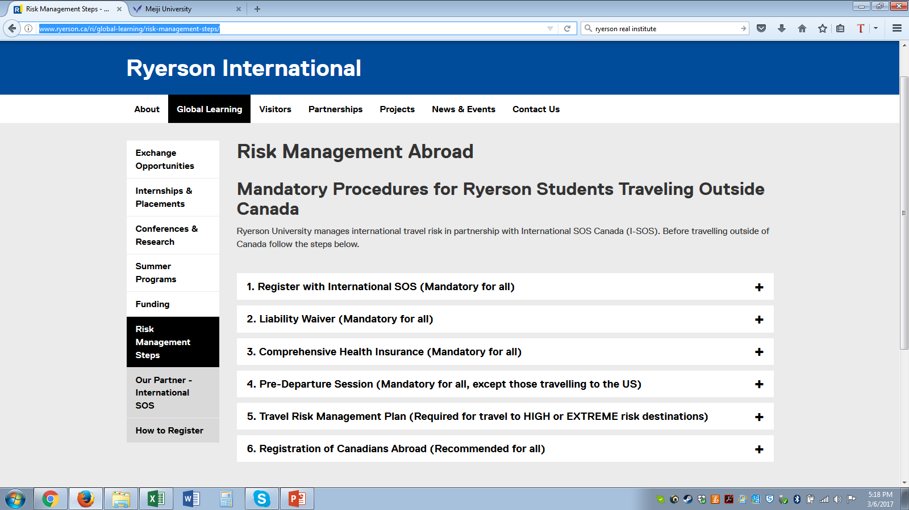
Pre-Departure Protocols

Slide 27
Our Partner – International SOS
Contact International SOS anytime, anywhere
No issue is too small - your virtual advisor for both critical and routine questions:
  Advice before your trip;
  A referral for a local doctor, dentist or other care;
  Routine or urgent medical care, including an evacuation;
  Safety or security advice from a trained professional.
See membership information for details and download the app!

Slide 28
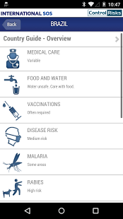
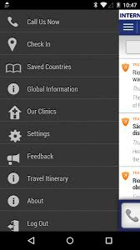
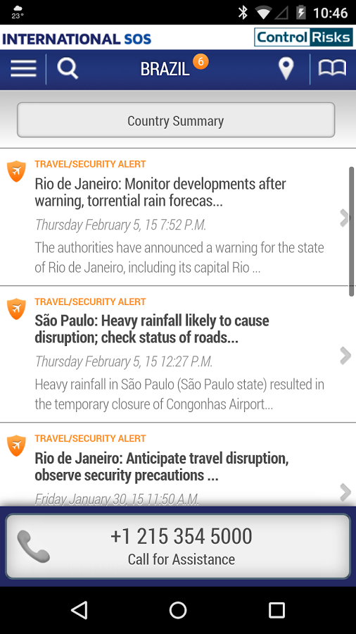
International SOS-Get the App!

Slide 29
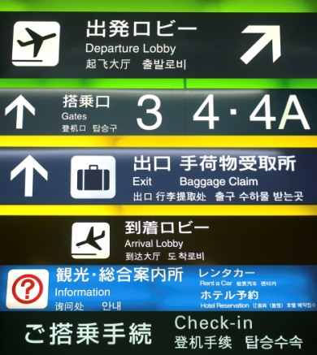
General Safety Tips:
Arrival & Departure
Most vulnerable situations while traveling
Keep all carry-on luggage strictly within your control at all times.
  Take it with you even when going into the washroom.
  Only carry on luggage that you can safely maneuver and control.
Watch for persons in airports or other terminal destinations who seem to be watching persons more than travel schedules, etc.

Slide 30
Safety & Security
General Tips
Potential Risks
Common Sense

Slide 31
Safety Tips - General
Key concepts:
Pay attention to your surroundings – use active awareness
Pay attention to how you carry yourself – avoid looking like a ‘tourist’

Slide 32
General Safety Tips:
Arrival & Departure
Most vulnerable situations while traveling
Keep all carry-on luggage strictly within your control at all times.
  Take it with you even when going into the washroom.
  Only carry on luggage that you can safely maneuver and control.
Watch for persons in airports or other terminal destinations who seem to be watching persons more than travel schedules, etc.

Slide 33
Safety Tips
Walk confidently and in a manner that suggests that you know where you are going.
  Suspects are on the look out for potential travelers who appear lost and confused.
Carry your passport on your person in a safe and secure manner.
  Money belt a very good idea – used properly
  Be aware of your possessions and how you carry them.
  The safest place for your valuables is the hotel safe
Don’t ignore your intuition.
  If you have a bad feeling about a situation, get out.

Slide 34
Safety Tips
Don’t be baited into a confrontation
Go with a group when possible, especially when going out for the evening
  Watch over each other
  Be aware that you can also be distracted BY the group
To avoid being a target, dress conservatively.
  Don't wear expensive-looking jewelry.
USE YOUR COMMON SENSE

Slide 35
Potential Risks
Streets & Sidewalks
Pick Pocketing & Bag Snatching
Political unrest
Assault/mugging
Available Level of Medical Care
Mosquitoes
Water and Food
Scams
Altitude

Slide 36
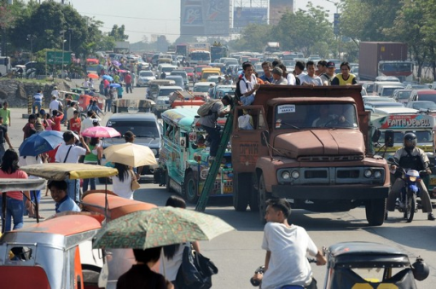
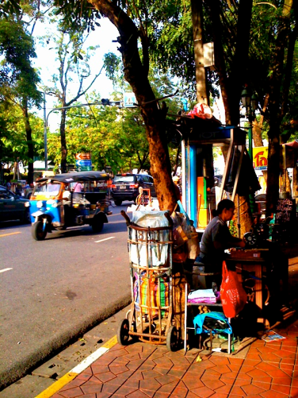
Streets & Sidewalks
More tourists are injured by traffic than anything else
Obvious – look both ways, and keep an eye on approaching traffic – not just cars, but motorcycles too
Traffic rules are not always respected in the same way as you are used to in Toronto – do not expect right of way as a pedestrian!
    Watch your step - be aware of steep curbs, uneven cobbles, construction debris, low signs, awnings, vendor cart refuse, sleeping dogs (or people) and anything else that could trip you up (potentially falling into traffic)

Slide 37
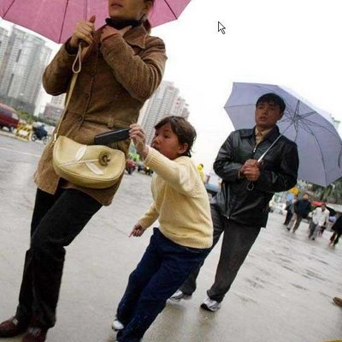
Pickpocketing & Bag Snatching
Most common in areas frequented by foreigners
  particularly in both very crowded and nearly empty areas (markets, airports, train/bus stations, public transit, etc.).
  Be aware of distraction ploys
Be aware of your surroundings
Stay alert, keep track of your belongings
  Keep your mobile device HIDDEN
  How do you carry your purse or wallet?
  What about when you sit down for a meal or drink?

Slide 38
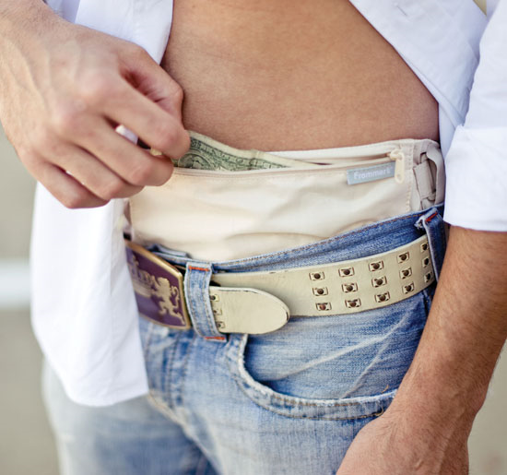
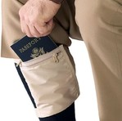
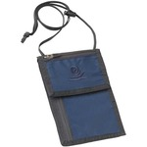
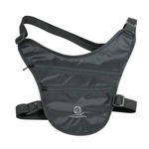
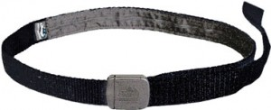
Money Belts
Use one – use it properly
“Keep it secret, keep it safe”
Choose a style that suits your type of activity and personal style
DO NOT ‘dig in’ in public (keep using your wallet or purse for day-to-day expenses)

Slide 39
Political Unrest
Avoid all forms of rally, protest or political gathering
  Always possibility for violence (police involvement, rival parties, etc.)
  Government response very different in different jurisdictions (Canada relatively mild by comparison)
  Follow local affairs in the news – before and during trip

Slide 40
Assault/Muggings
  Less common than pickpocketing/bag snatching
  DO NOT RESIST – can easily turn violent
    Opposite in case of sexual assault
  Some travelers carry a ‘decoy’ wallet
  Go to the ATM with a buddy… you are always safer in a group, especially out at bars/clubs, at night, etc.

Slide 41
Drugging
Number of different substances can be slipped into food or drink, cigarettes or sprayed, etc.
Never leave belongings unsupervised
Don’t take food/drink/cigarettes offered by strangers
Watch your drink being poured
Always safest as a member of a group
Keep an eye on each other’s behaviour,
note sudden changes

Slide 42
Pack your common sense!
Don’t take unnecessary risks
  Travellers take risks abroad that they never would at home like in terms of alcohol, drugs,
Be aware of your surroundings and belongings
Know who and how to ask for help
Avoid drawing undue attention to your status as an tourist/outsider - you may not ‘blend in’, but don’t need to ‘stick out’
If in doubt, ask (a trusted source)

Slide 43


Your Excellency…
You are an Ambassador for Ryerson, Toronto and Canada
The value of your degree is directly related to Ryerson’s reputation
  If you hurt that reputation, the value of your degree is lessened
  Think about your actions – a positive impression is a value to the entire community
Know a bit about Ryerson and take pride in representing us

Slide 44
Emergencies
You should know:
  Health insurance provider and membership #
  Canadian mission contact information
  Local emergency number is 112
  International SOS membership
Familiarize yourself with what the Canadian embassy, consulate or HC can and cannot do for you
Be aware of any policies/procedures put in place by host organization or site

Slide 45

In Closing
Be sure to:
Visit www.ryerson.ca/ri to:
  register your participation
  check out our online travel resources
Arrange for health and/or travel insurance
Prepare a budget, a map and information to leave at home
Take the time to learn at least a few key phrases
Take the safety tips and risk management steps to heart…but don’t forget to enjoy yourselves
HAVE A FANTASTIC TRIP

